Slide 1

Les Clefs d’Or®
Union Internationale des Concierges d’Hôtels
About Les Clefs d’Or
Copyright 2023 UICH Les Clefs d’Or
1

Slide 2

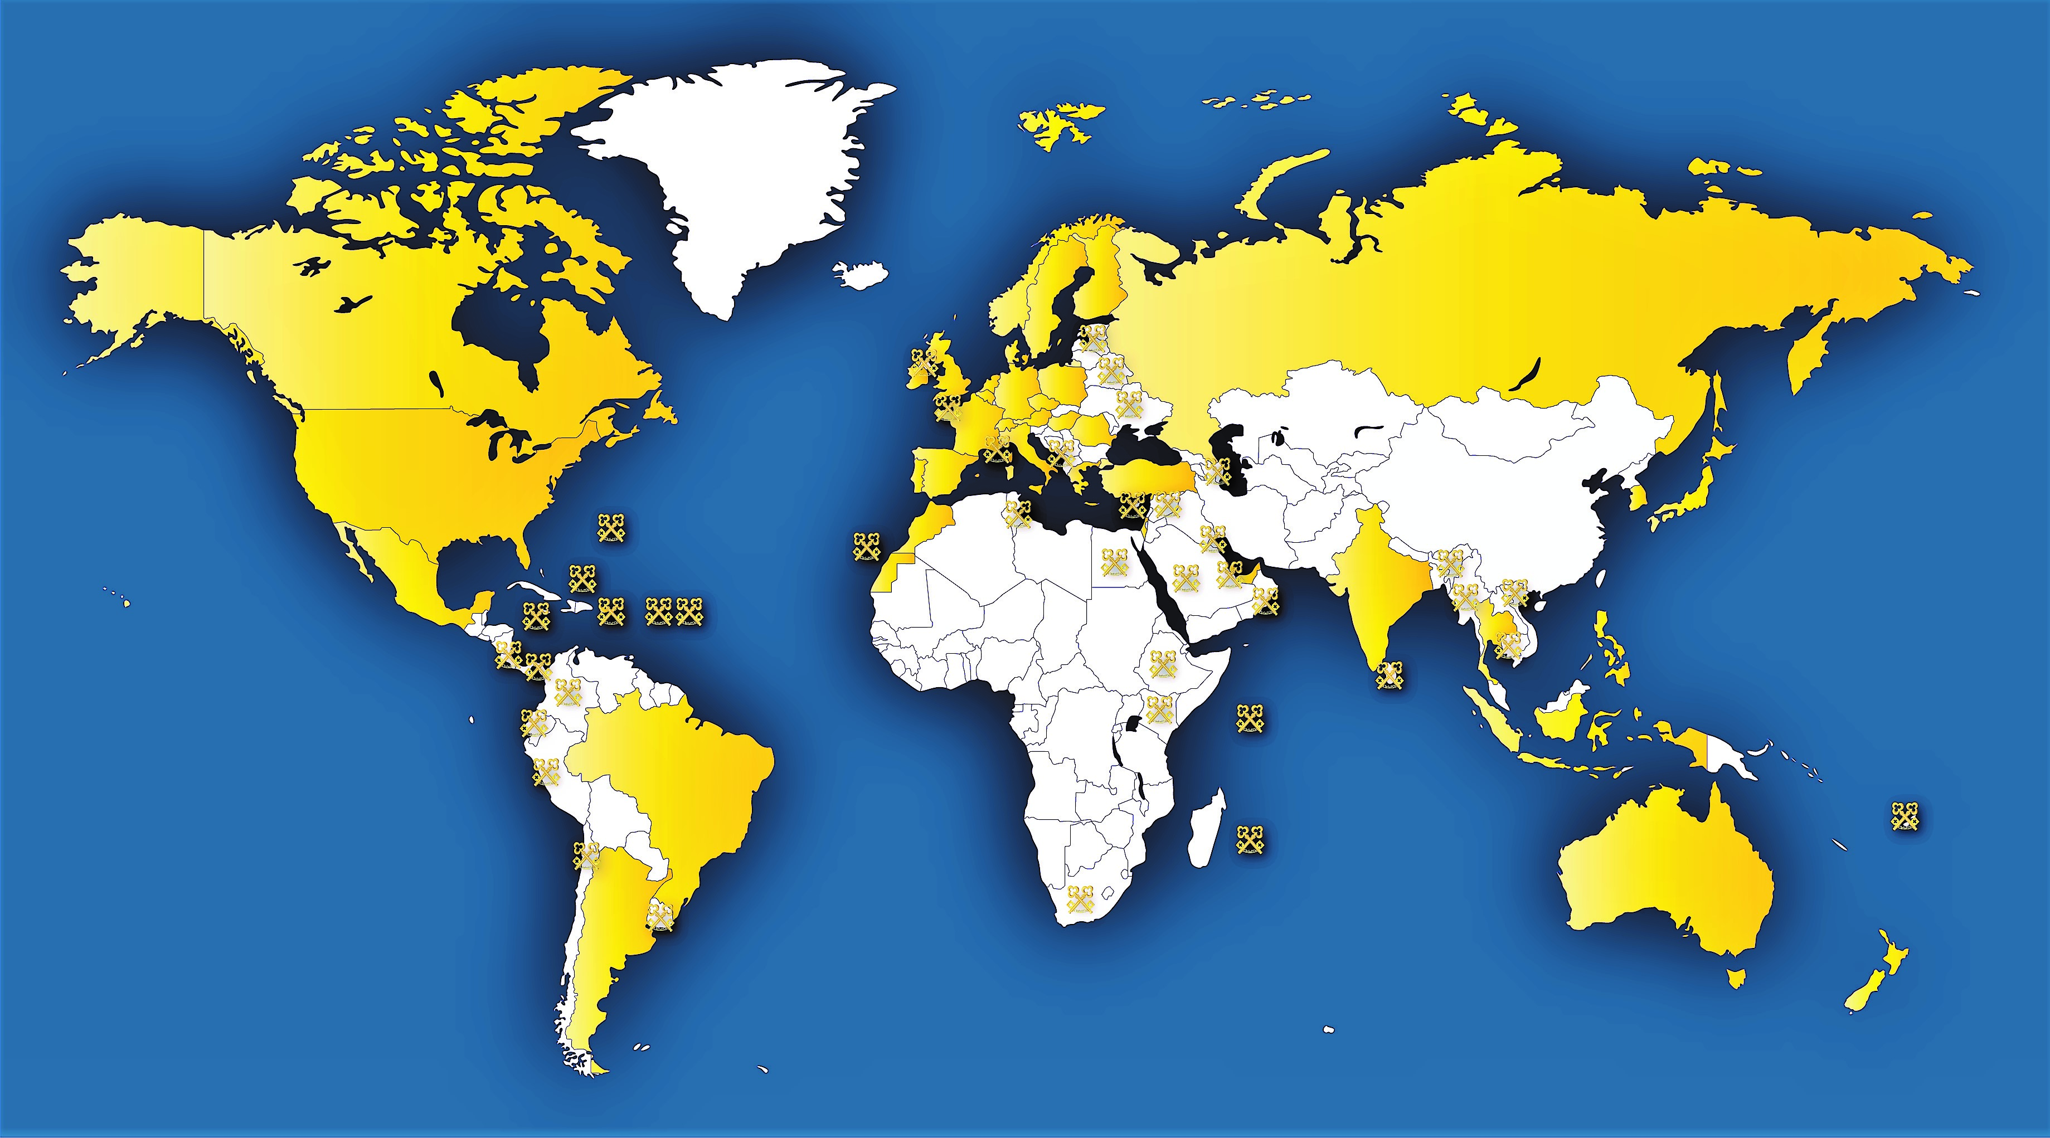
Map of Les Clefs d’Or Sections and Membership Locations

Slide 3


What is a Concierge?
Concierge \kon-syersh\n. Doorkeeper; Keeper of the keys
Les Clefs d’Or\lay clay d’or\ n. The translation from
French is literally: “The Golden Keys”
A Les Clefs d’Or Concierge is first and foremost a hotel
concierge dedicated to serving the needs of his or her guests.
The concierge is a ‘hospitality and tourism professional’ with an intimate knowledge of his or her city who acts as an ambassador for all that city offers.
The association of Les Clefs d’Or is dedicated to the maintenance and continual creation of an unrivalled level of excellence in customer service despite a faster-moving world and ever-changing guest demands.
3

Slide 4
Les Clefs d’Or - Your Key to Everything
Les Clefs d’Or (translated as The Golden Keys) is a professional
association of hotel concierges, with approximately 3200
members working in over 80 countries and 530 destinations,
in literally every corner of the world. Easily identified by
the golden crossed keys on their lapels, these members are
an elite fraternity, globally connected, committed to
professional development, and driven to setting new standards
for guest service perfection.
The French section of Les Clefs d’Or was formed by Pierre Quentin in 1929 while our international association was officially founded in France in 1952 by Ferdinand Gillet along with the European Presidents of Germany, Denmark, Great Britain (with Ireland), Italy, Switzerland and Belgium. Our association was founded as a not-for-profit organisation based on two pillars: Service and Friendship.
4

Slide 5
Les Clefs d’Or - Your Key to Everything
Before earning the right to wear the golden keys, those who
aspire to become a member must have several years of
experience as a hotel concierge, passing comprehensive testing
And prove, beyond doubt, their ability to deliver the highest
Quality of service.
Serving more than 127 million guests every year, Les Clefs d’Or members fulfil an infinite variety of requests from every day to the extraordinary. As lifelong professional hotel concierges, their experience, knowledge and professional relationships make them the most reliable local experts and ambassadors of their chosen destinations.
With every member having access to Les Clefs d’Or‘s global network, often meeting face-to-face at one of their annual international congresses, there is nowhere they cannot reach or guest requests they cannot deliver. No one knows the world like Les Clefs d’Or. From Berlin to New York City, Paris to Tokyo, and everywhere in between, Les Clefs d’Or concierges strive to provide nothing short of inspired service.
5

Slide 6
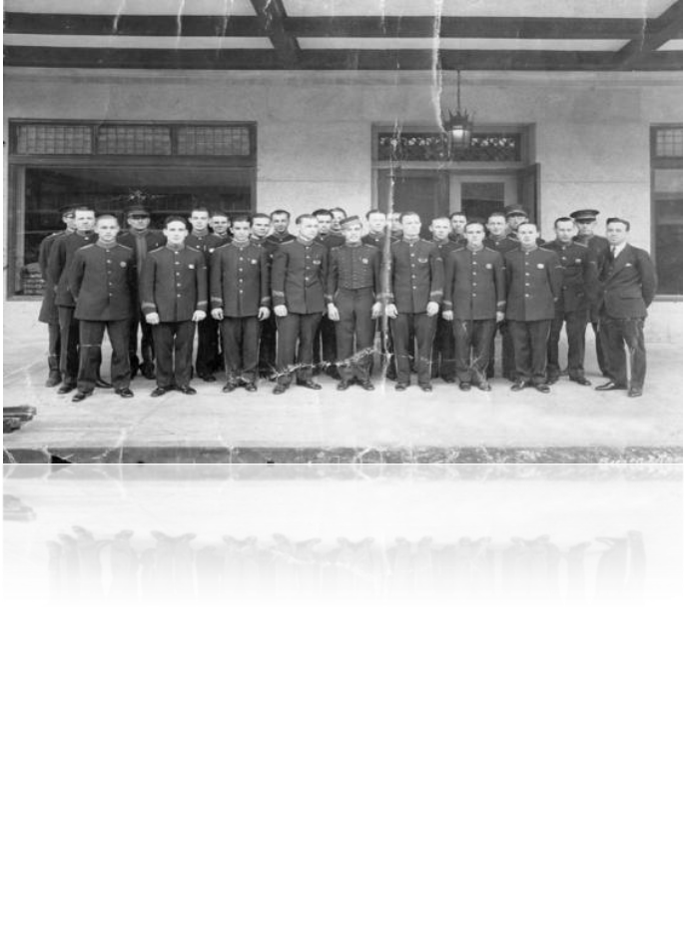
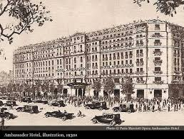
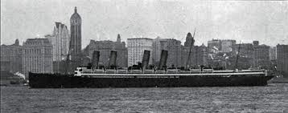
Les Clefs d’Or History
The Early Years
19th Century travel and tourism flourished in Europe; railroad expansion and steamship travel dramatically increased mobility throughout Europe. In response, a large number of hotels were built to accommodate this newly created demand for lodging.
The hotel porter or doorman became the focal point of many luxury hotels’ guest relations and customer service. During this time, the concierge’s role was created in the Grande Dame hotels of Paris and Western Europe. This was the first time a role had been specifically created to assist guests with their requirements in unfamiliar cities. The concierge quickly became a popular and essential service in luxury hotels.
During the mid 1920s, a group of concierges from various hotels in Paris (including one from Algeria) were trying to organise themselves with the guidance of Mr Pierre Quentin from the Hotel Ambassador. The hotel opened in 1928 and played host to a ceremony in honour of Charles Lindbergh’s cross-Atlantic journey in 1927. The following year, Paris welcomed landmark hotels like Hotel Lancaster, The Prince de Galles, and the George V.
6

Slide 7
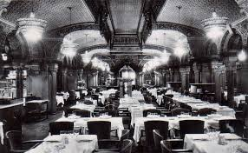
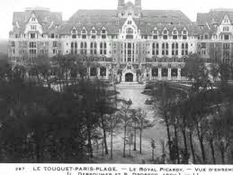
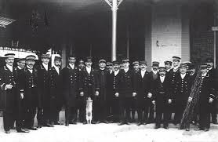
Les Clefs d’Or History
On 26 October 1929, Mr Pierre Quentin sent an invitation to 20 prominent concierges throughout Paris to dine at Restaurant Noël Peters in the hopes of strengthening the bond among them. The restaurant was located across the street from his hotel in the Passage des Princes. With 11 in attendance, this dinner marks the first instance of professional hotel concierges meeting as a group.
November 27, 1929
The new association was ratified at the first-ever General Assembly, with more than 75 delegates present. Mr Pierre Quentin was elected the first President of Les Clefs d’Or, a post he held for three years.
In 1935, Mr Ferdinand Gillet was elected Vice President. While in office, he organised a special meeting in La Touquet for French and British concierges to gather together in a convenient location. He continued to organize this event annually until 1940.
7

Slide 8
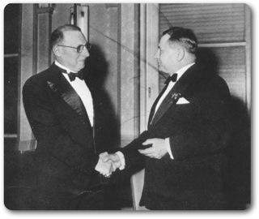
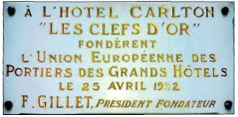

Les Clefs d’Or History
1936 The headquarters of Les Clefs d’Or moved to its present location at 12 rue Cambon in Paris.
During his presidency, Ferdinand Gillet travelled extensively throughout Europe to seek and find other hotel concierges. After much communication and several smaller meetings, he finally gathered the first six member sections on the historic date of April 25, 1952, at The Carlton Hotel in Cannes, which was, in theory, the birth of Union Internationale des Concierges d'Hôtels «Les Clefs d'Or,» the international network as we know it today, and the very first international congress. Present were France, Italy, Switzerland, Germany, Great Britain, and Ireland. Belgium and Denmark were observing countries, and Spain was an invited guest.
On August 27, 1940, the President of Les Clefs d’Or, Mr Francois Dechaume, was arrested by the Germans and sent to prison until 1941. In his absence, Vice President Ferdinand Gillet took over his duties and was eventually officially elected President.
8

Slide 9
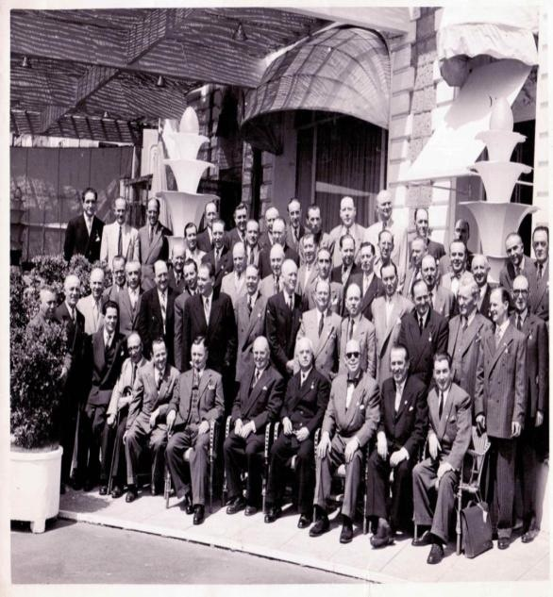
Les Clefs d’Or History
The Carlton
Hotel Cannes
April 25, 1952
9

Slide 10




Les Clefs d’Or History
Les Clefs d’Or: Chronology
In 1970 in St. Moritz, UEPGH Les Clefs d’Or (Union Européenne des Portiers des Grands Hôtels "Les Clefs d'Or") changed its name to UIPGH Les Clefs d’Or (Union Internationale des Portiers des Grands Hôtels "Les Clefs d'Or") to accommodate the organization as it began to grow outside of Europe.
In 1976, Canada was admitted as the 18th member section and the first country that took UIPGH Les Clefs d’Or to the next continent. In 1978, the USA was accepted.
In 1981, Australia was accepted, and this paved the way for Asia to join the UIPGH Les Clefs d’Or family. Soon after, Hong Kong became a section (in 1983).
In 1998, the organization officially became UICH (Union Internationale des Concierges d'Hôtels "Les Clefs d'Or") to emphasize the word concierge and to further reinforce that the organization is an association of hotel concierges.
10

Slide 11
Les Clefs d’Or History
History of Sections
History of Presidents
1952: France
Germany
Great Britain
Italy
1953: Switzerland
1954: Belgium
Denmark
1955: Austria
1956: Sweden
1960: Holland
Ireland
1962: Norway
Spain
1964: Morocco
1965: Hellas
1970: Israel
1972: Portugal
1976: Canada
1978: USA
1980: Finland
1981: Australia
1983: Hong Kong
1985: Hungary
1986: Singapore
1989: Luxembourg
1991: Romania
Czech Republic
1992: Brazil
1993: Philippines
1994: New Zealand
1997: Mexico
China
Japan
Malaysia
2001: Russia
2003: Chinese Taipei
Turkey
2005: Thailand
2006: Korea
2008: Argentina
2009: UAE
2011: India
2012: Poland
2014: Qatar
Macau
2018: Indonesia
1952 - 1968: F. Gillet (France)
1968 - 1969: T. Godde (Germany)
1969 - 1972: O. Wirth (Switzerland)
1972 - 1974: R. Burdeyron (Great Britain)
1974 - 1976: A. Molero (Spain)
1976 - 1978: J. Gillet (France)
1978 - 1982: S. Giarola (Italy)
1982 - 1985: A. Schneider (Austria)
1985 - 1986: J.M. Bautista (Spain)
1986 - 1988: A. Ostertag (Switzerland)
1988 - 1991: A. Damonte (Great Britain)
1991 - 1992: W. Freytag (Germany)
1992 - 1995: A. Lodigiani (Italy)
1995 - 1997: T. Facciolo OAM (Australia)
1997 - 1999: A. Gunst (Hungary)
1999 - 2001: M. Silverman (USA)
2001 - 2003: A. Giacomello (Switzerland)
2003 - 2005: J.C. Elgaire (France)
2005 - 2007: D. O’Brien (Ireland)
2007 - 2009: R. Bastoni (France)
2009 - 2011: R. Watson (USA)
2011 - 2013: V. Casale (Canada)
2013 – 2015: E. Vrettos (Hellas)
2015 – 2017: C. Toomey (Australia)
2017 - 2019 S. Thomas (Great Britain)
2019 - 2021 R. Levejac (France)
2021 - 2023 A. Ølsted Jensen (Denmark)
2023 - R. Santos (Qatar)
11

Slide 12

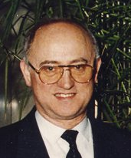
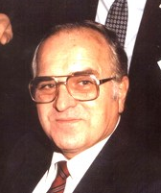
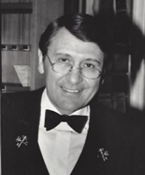
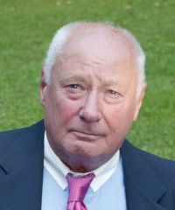
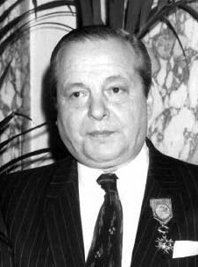
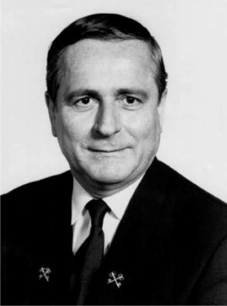
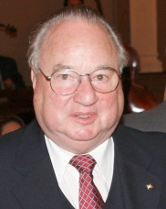
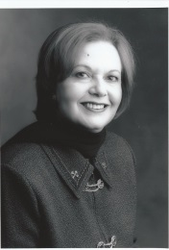
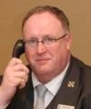
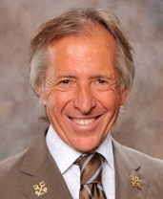
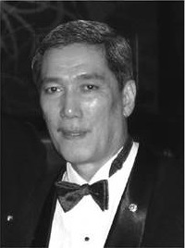
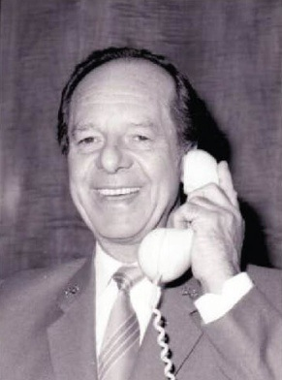
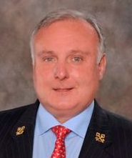
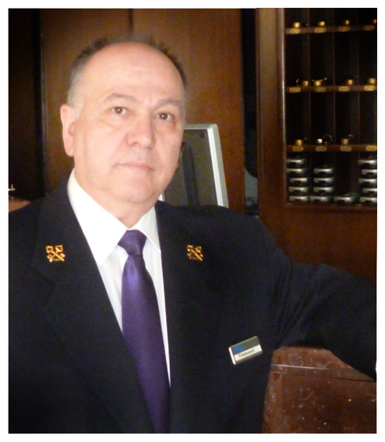
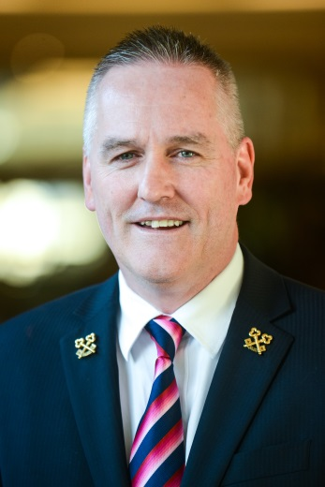
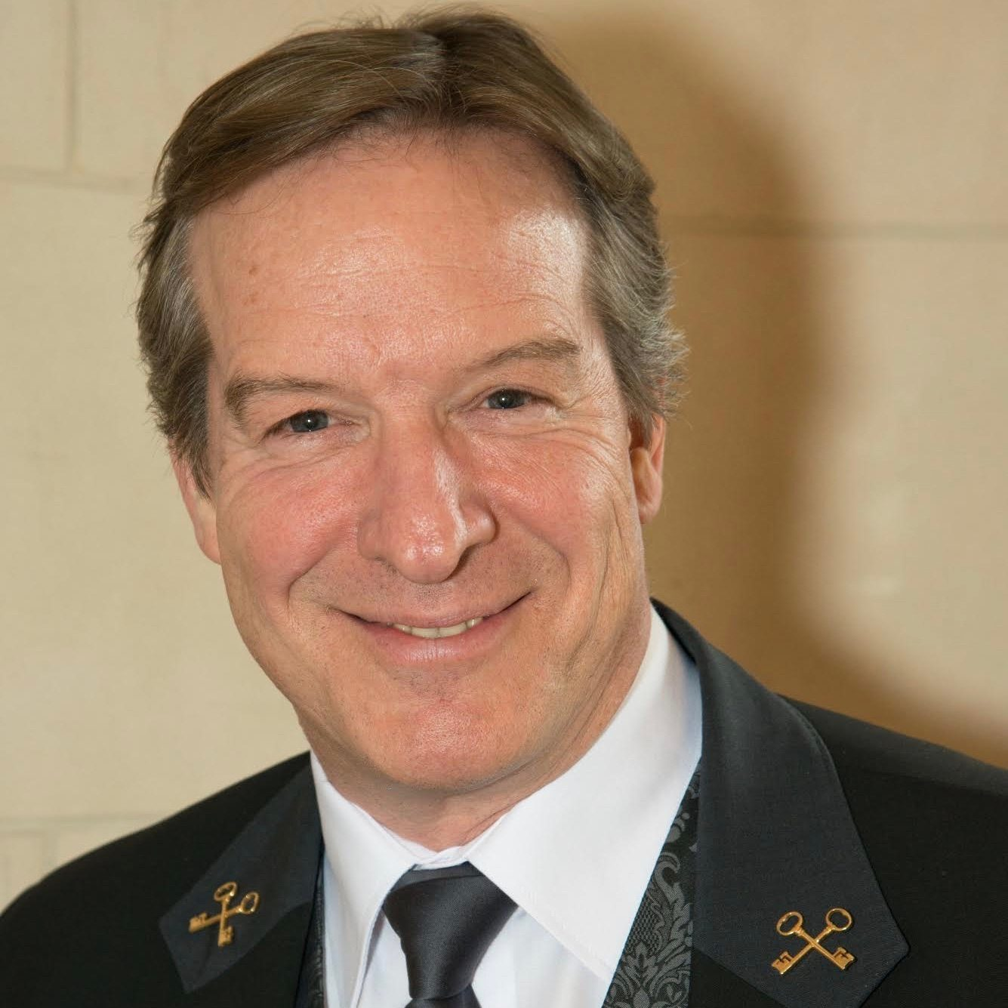
President d’Honneur & Comité des Sages
Adolf SCHNEIDER (Austria)
Past President 1982-1984
Président d'Honneur (deceased)
José-Maria BAUTISTA (Spain)
Past President 1984-1986
Président d'Honneur (deceased)
Albert OSTERTAG (Switzerland)
Past President 1986-1988 Président d'Honneur
Walter FREYTAG
(Germany)
Past President 1991-1992 Président d'Honneur
(deceased)
Jean GILLET (France)
Past President 1976 - 1978
Président d'Honneur
Grand Conseiller à Vie (deceased)
Cav Tony FACCIOLO OAM
(Australia)
Past President 1995 - 1997
Président d'Honneur
Ambassadeur à Vie (deceased)
Andras GUNST
(Hungary)
Past President 1997-1999 Président d'Honneur
(deceased)
Marjorie SILVERMAN
(USA)
Past President 1999-2001 Président d'Honneur (deceased)
Denis T.C. O’BRIEN
(Ireland)
Past President 2005-2007
Président d'Honneur
(deceased)
Roger BASTONI
(France)
Past President 2007-2009
Président d'Honneur
Andy PONGCO (Philippines)
Président d'Honneur (deceased)
André DAMONTE (Great Britain)
Past President 1988 - 1991
Président d'Honneur (deceased)
Robert WATSON
(USA)
Past President 2009-2011
Président d'Honneur
Emmanuel VRETTOS
(Hellas)
Past President 2013–2015
Président d'Honneur
Colin TOOMEY
(Australia)
Past President 2015-2017
Président d'Honneur
Roderick LEVEJAC
(France)
Past President 2019-2021
Président d'Honneur
12

Slide 13
Les Clefs d'Or » Congresses
Chronology of Les Clefs d'Or International Congress
Host Cities of Les Clefs d'Or International Congress Host Cities
1951: Sierres*
1952: Cannes
1953: San Remo
1954: Munich
1955: Marrakesh/Paris
1956: Montreux
1957: Dublin
1958: Brussels/Berlin
1959: London/Lourdes
1960: Amsterdam
1961: Vienna
1962: Copenhagen
1963: Nice
1964: Tangier/Casablanca
1965: Madrid
1966: Geneva
1967: Athens
1968: Brussels
1970: St. Moritz
1971: Dublin
1972: Palma de Mallorca
1973: Munich
1974: Tel Aviv
1975: London
1976: Lisbon
1977: Copenhagen
1978: Vienna
1979: Rome
1980: Monte Carlo
1981: Dublin
1982: Barcelona
1983: Funchal/Madeira
1984: Munich
1985: Sorrento
1986: Tel Aviv
1987: Washington DC
1988: Budapest
1989: Paris
1991: Gothenburg
1991: Costa del Sol
1992: Marrakech
1993: Singapore
1994: Sydney
1995: Jerusalem
1996: Rome
1997: Budapest
1999: Prague
2000: Guangzhou
2001: Brussels
2002: Athens
2003: Biarritz
2004: Tangier/Fes
2005: Manila
2006: Washington DC
2007: Vienna
2008: Copenhagen
2009: Hangzhou
2010: Lisbon
2011: Toronto
2012: London
2013: Queenstown
2014: Kuala Lumpur
2015: Mendoza
2016: Dubai
2017: Berlin
2018: Seoul
2019: Cannes
2020: New Delhi (cancelled)
2023: Istanbul
2024: Bali
Future Congresses:
2020: Delhi, India (March 26-31)
2021: Doha, Qatar
(March 27-April 1)
13

Slide 14


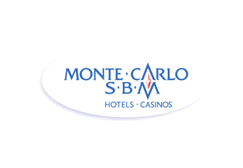












Les Clefs d'Or Award (Young Concierge of the Year)
Candidate Qualifications
Candidates must be:
A Clefs d’Or member.
Nominated by his/her member section.
Fluent in English.
Participating at his/her first international congress.
Under 35 years of age at the start of the General Assembly.
Have the title Concierge and a hotel-issued business card.
Past Winners:
2008 Tony Chang (Chinese Taipei)
Sponsored by American Express
2009 Christophe Caron (France)
Sponsored by Elite Rent-a-Car
2010 Benjamin Malpass (Great Britain)
Sponsored by Gold Key Solutions
2011 Anabella Peling (Argentina)
Sponsored by Lucien Barrière
2012 Matthew Wu (Canada)
Sponsored by Concierge Organizer
2013 Anna Endrihovskaia (Russia)
Sponsored by GoConcierge
2014 James Elliott (United Kingdom)
Sponsored by Sofitel
2015 Sarah Dandashy (USA)
Sponsored by Hublot/Bucherer
2016 Harald Exbrayat (France)
Sponsored by Four Seasons Hotels
2017 Jessica Gorman (USA)
Sponsored by Shangri-la Hotels
2018 Jennifer Brody (USA)
Sponsored by Oetker Collection
2019 Raphaelle Grandgirard (Switzerland)
Sponsored by Societé de Bains de Mer
2022 Angelica Miozza (USA)
Sponsored by Intercontinental Hotels
2023 Magali Brandariz (Argentina)
Sponsored by Mandarin Oriental
Point System for Judging
(Total: 1500 points):
Exam (4 parts totalling 885 points)
Video (100 points)
Key to the City article (215 points)
Conduct, Personality & Charisma (300 points)
History of the Award
The award was created in 2008 as a way to honour the memory of Andy Pongco (InterContinental Manila), whose passion was to mentor young concierges. Had illness not prevailed, Mr. Pongco would have been elected International President in Vienna in 2007.
Each year the award honours the memory of a past Les Clefs d’Or visionary . Other honorees have included Marjorie Silverman, Andre Damonte, and Pierre Quentin.
Candidates complete a comprehensive written exam on the history of Les Clefs d’Or, geography and general knowledge. They submit an essay on their interest in the profession as well as their aspirations. In addition, candidates must do special projects (produce a video and write a Keys to Your City article for the UICH website). Each year is slightly different as the award is ever-evolving. At the congress, candidates undergo personal interviews. Presentation and personality count toward the final outcome of this friendly contest.
14

Slide 15
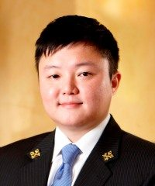
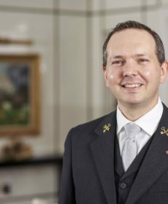
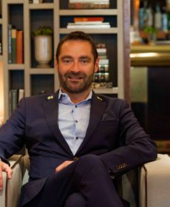
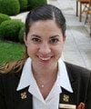
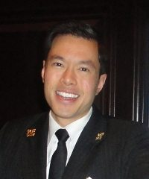
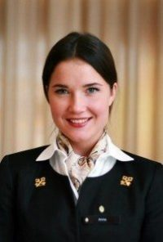
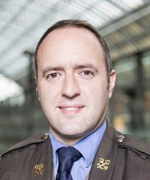
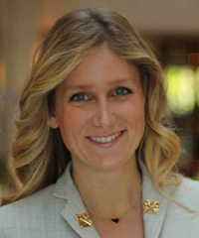
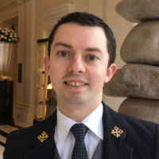
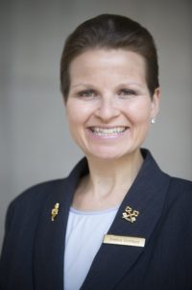
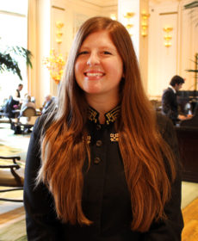
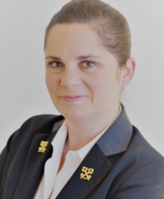
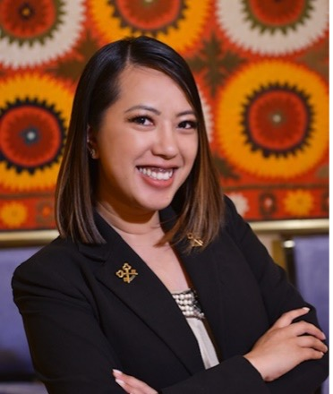
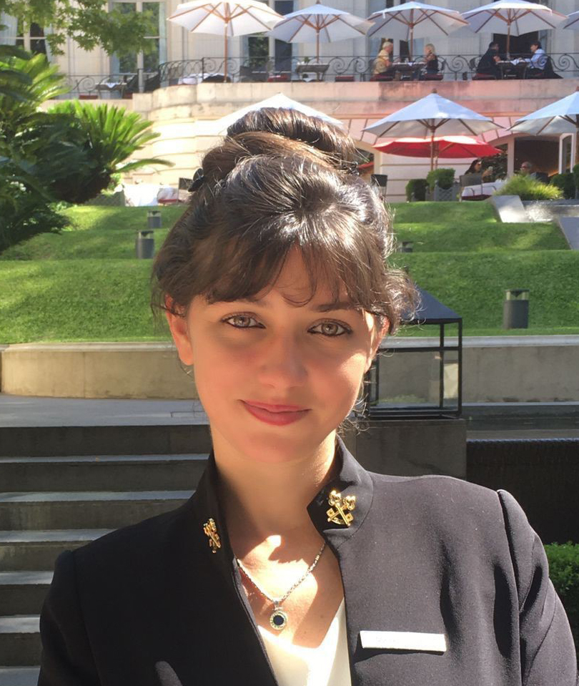
Young Leader Winners
Celebrating
the
Future
while
honoring
the
past
Tony Chang (Chinese Taipei)
Christophe Caron (France)
Ben Malpass (Great Britain)
Anabele Peling (Argentina)
Matthew Wu (Canada)
Anna Endrihovskaia (Russia)
James Elliott (Great Britain)
Sarah Dandashy (USA)
Harald Exbrayat (France)
Jess Gorman (USA)
Jennifer Brody (USA)
Raphaelle Grandgirard (Switzerland)
Angelica Miozza(USA)
Magali Brandariz (Argentina)
15

Slide 16
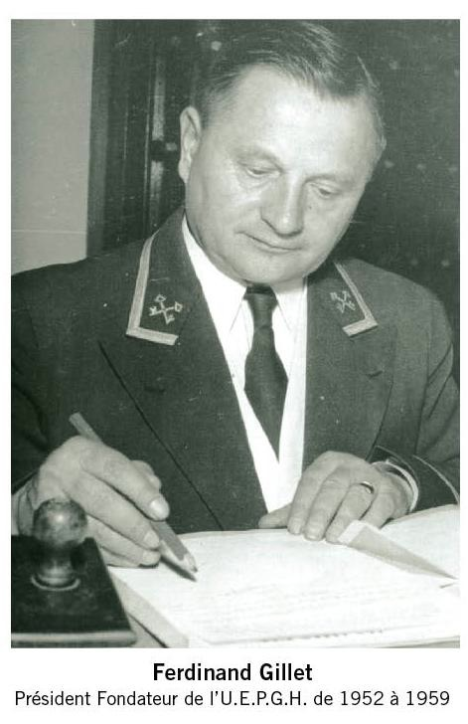
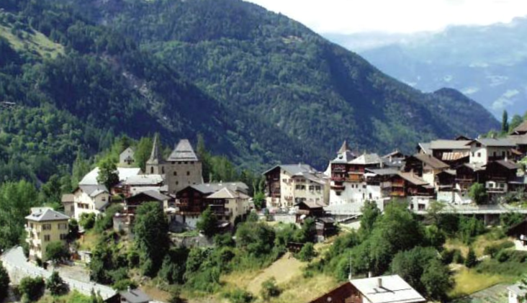
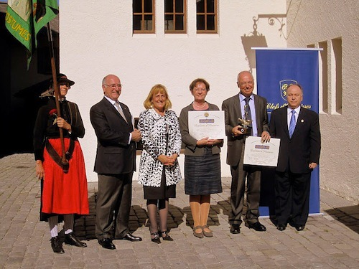
Les Clefs d'Or » The Legacy of Ferdinand Gillet
Historic Vissoie, Switzerland
In 2011, by mayoral proclamation, Vissoie became the “City of Friendship”
Ferdinand Gillet
Founder President, UEPGH
Les Clefs d’Or (1952 to 1968)
In Service Through Friendship
16

Slide 17
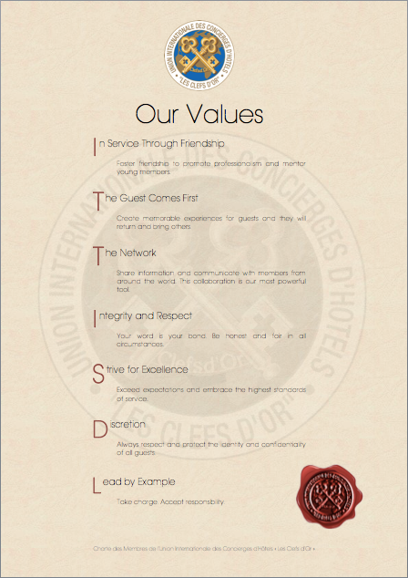
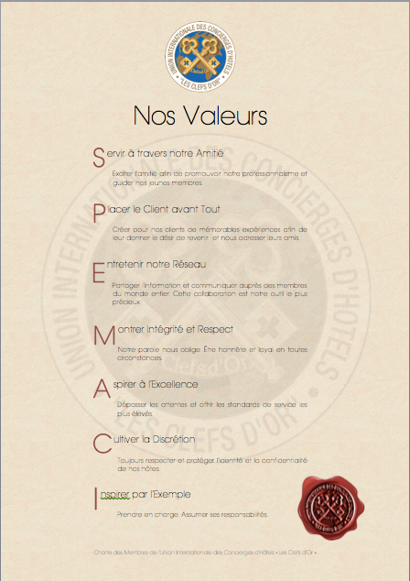
17

Slide 18
Les Clefs d’Or Brand Principles
Strive for Excellence
Lead by Example
In Service Through Friendship
Integrity and Respect
Discretion
The Guest Comes First
The Network
18

Slide 19
Les Clefs d’Or Organisational Chart
Les Clefs d’Or Executive Committee Organisational Chart
President
1st Vice President
2nd Vice President
3rd Vice President
General Secretary
ASSISTANT General Secretary
Treasurer
French President
Past International President
Les clefs d’or award COMMITTEE*
Education & TRAINING Committee*
Csr Committee*
Zone Directors*
Membership Committee*
Communications Team*
STRATEGIC Partnerships*
Sages*
*Reports to Executive Committee
19

Slide 20
Les Clefs d’Or Organisational Chart
Les Clefs d’Or Zones
Americas Zone Director
Western Europe Zone Director
Argentina
Brazil
Canada
Mexico
United States of America
Belgium
France
Great Britain
Holland
Ireland
Luxembourg
Morocco
Switzerland
scandinavia Zone Director
Central Europe Zone Director
FINLAND
SWEDEN
DENMARK
AUSTRIA
Germany
Czech Republic
HUNGARY
POLAND
ROMANIA
Russia
20

Slide 21
Les Clefs d’Or Organisational Chart
Les Clefs d’Or Zones, continued
Arabia & Western Asia Zone Director
Chinese Taipei
Hong Kong
India
Korea
Macau
Qatar
United Arab Emirates
Mediterranean Zone Director
Southeast Asia & Oceania Zone Director
Hellas
Israel
Italy
Portugal
Spain
Turkey
Australia
INDONESIA
Japan
Malaysia
New Zealand
Philippines
Singapore
Thailand
21

Slide 22
How Les Clefs d’Or Works
Les Clefs d’Or is structured so that the members have the final authority. Members ratify all recommendations at the Extended Annual General Assembly.
The General Assembly (Presidents of each section) is elected to represent the membership. Each of the 44 sections gets one vote at the meeting. Votes are taken on all recommendations made by the Executive Committee.
Zone Directors advise the Executive Committee on the operations of the Sections within their Zones.
The Executive Committee is elected to manage and run the association in accordance with our constitution.
The Sages (Ex-Presidents of the Association) act as trusted advisors to all levels of the association. They advise all levels of the association.
22

Slide 23
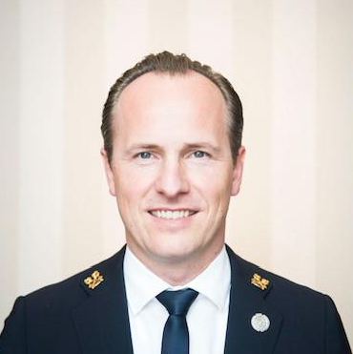
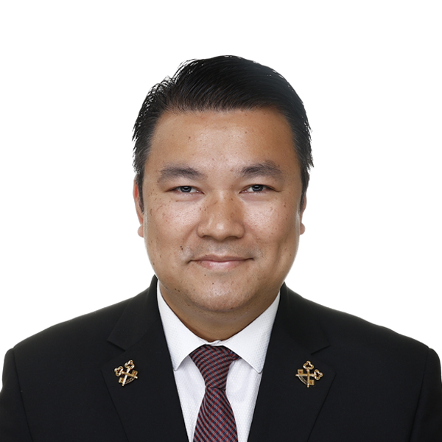
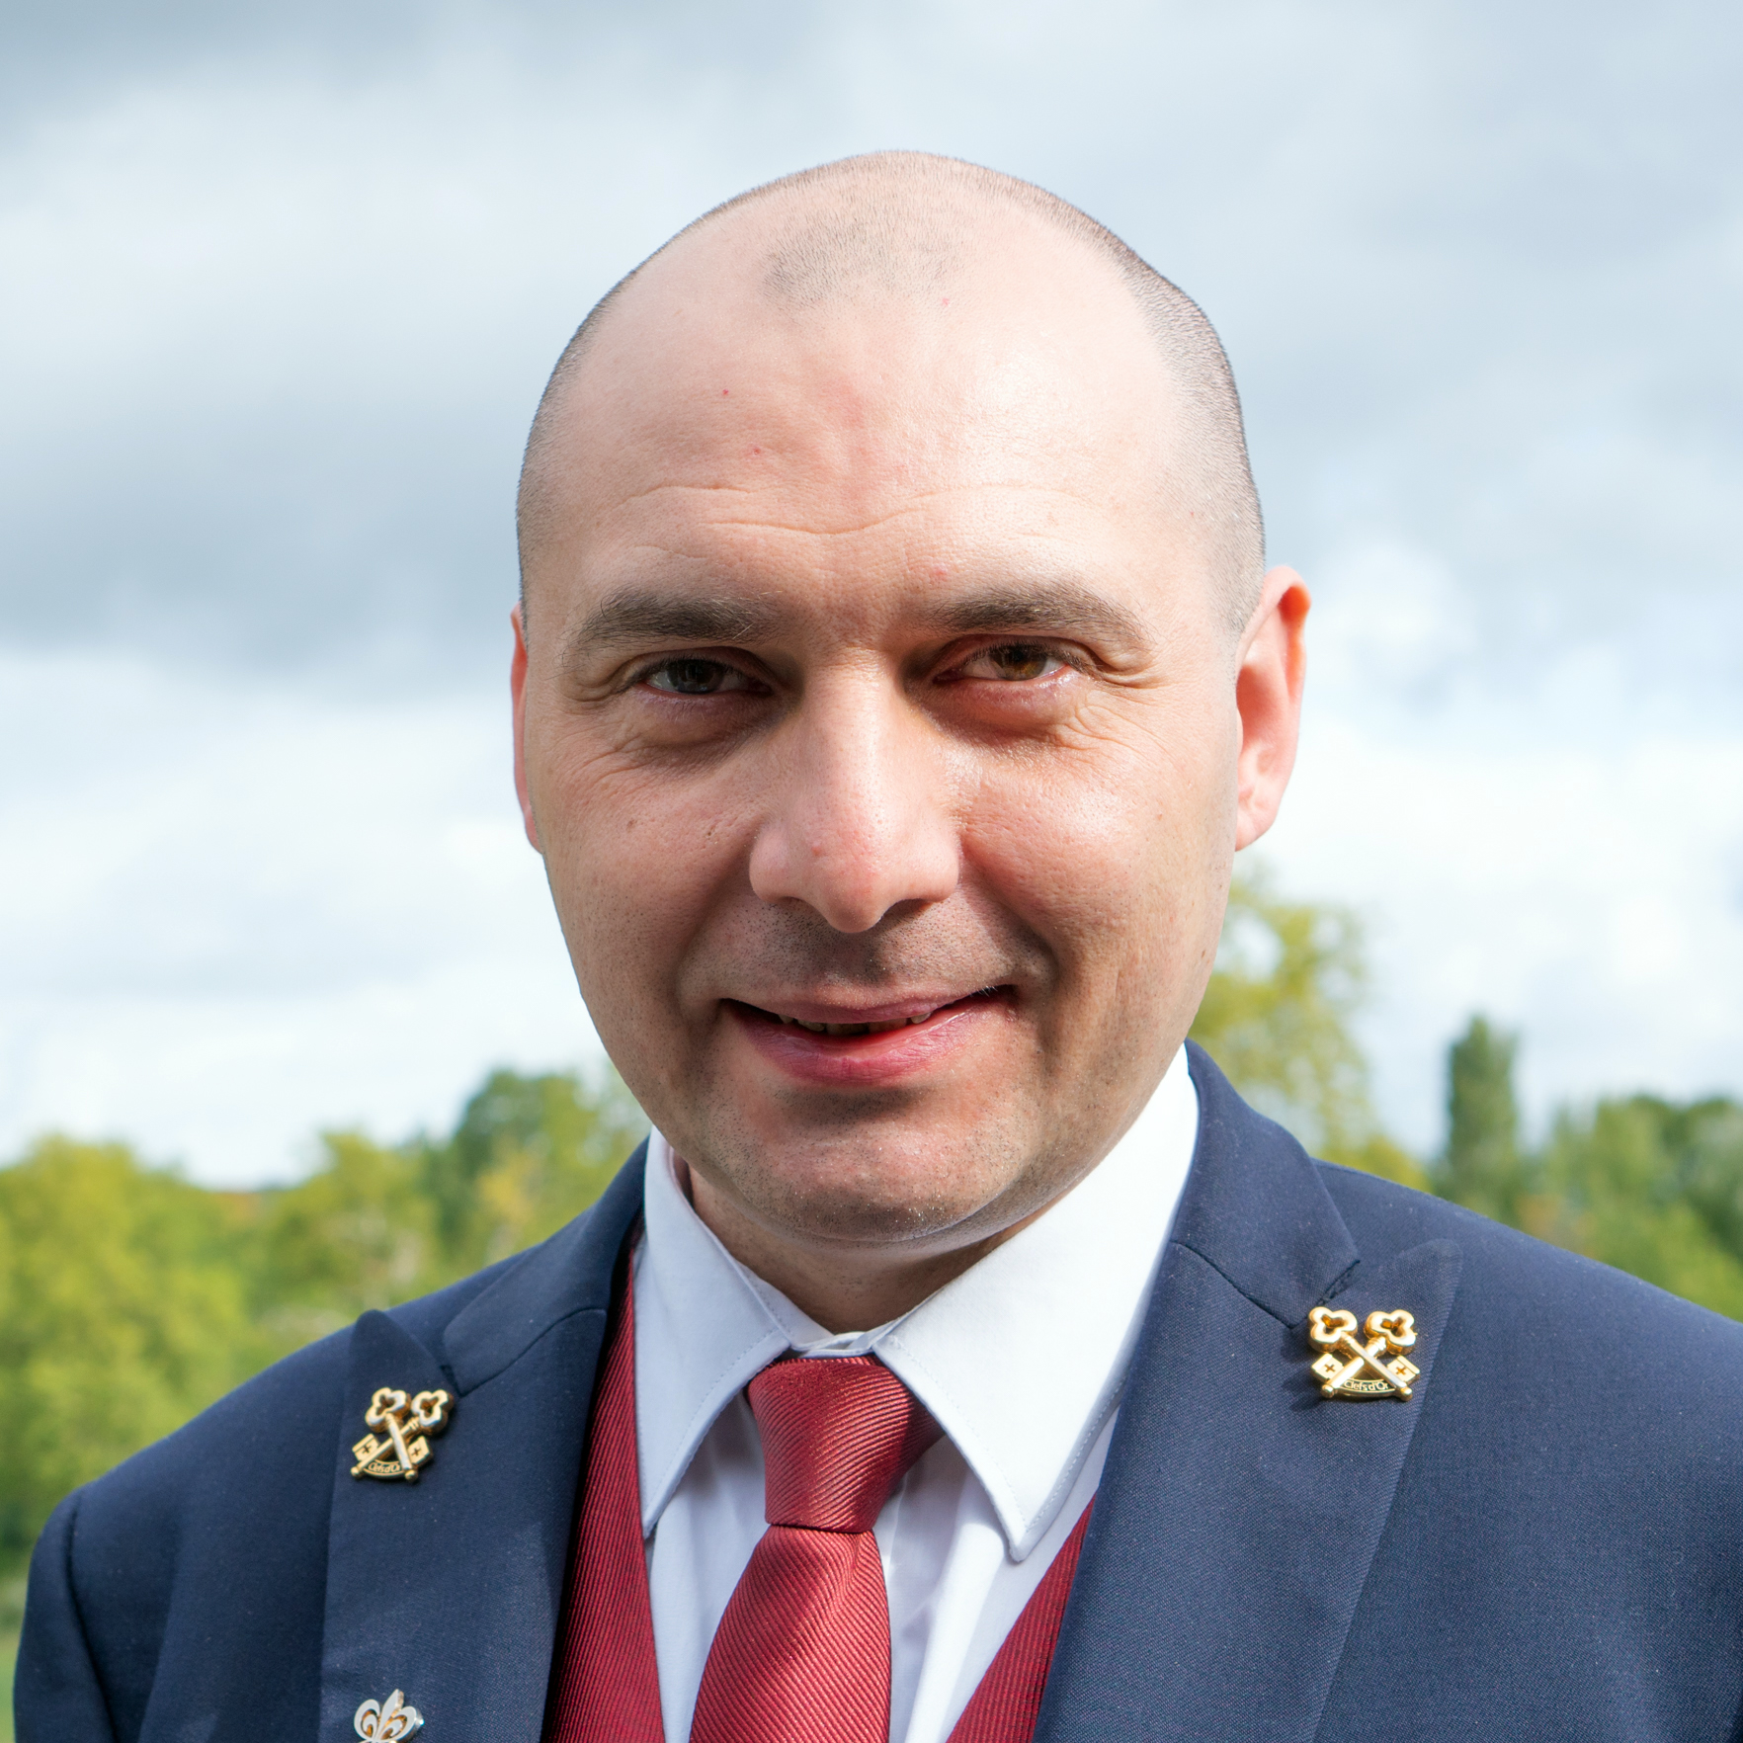
Les Clefs d’Or Leadership Team
Les Clefs d’Or 2023-2025 Executive Committee
Anders Ølsted Jensen
Past President
Chef Concierge
Skt. Petri
Copenhagen
Randy Santos
President
Chef Concierge
Fairmont
Doha
Dimitri Ruiz
President’s Representative
in Paris
Chef Concierge
Barriere Le Fouquet’s
Paris
23

Slide 24
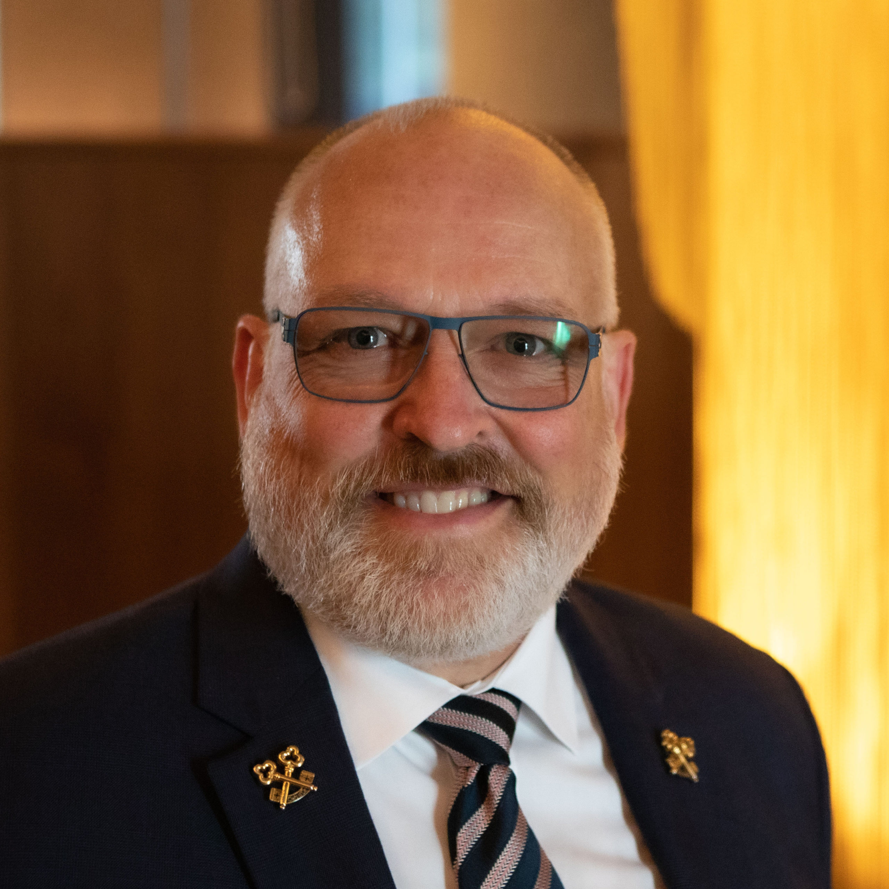


Les Clefs d’Or Leadership Team
Les Clefs d’Or 2023-2025 Executive Committee
James Ridenour
1st Vice President
Chef Concierge
The Next Hotel
Melbourne
Brian Mackenzie
2nd Vice President
Chief Concierge
NH Collection Barbizon Palace
Amsterdam
Robert Marks
3rd Vice President
Chief Concierge
Omni Hotel
San Diego
24

Slide 25



Les Clefs d’Or Leadership Team
Les Clefs d’Or 2023-2025 Executive Committee
Burak Ipekci
General Secretary
Chef Concierge
The Royal Horseguards
London
Sharezal Abdul Wahid
Assistant Secretary
Chef Concierge
The Majestic
Kuala Lumpur
Mathieu Glaser
Treasurer
Chief Concierge
Sofitel Grand Ile
Strasbourg
25

Slide 26








Les Clefs d’Or Zone Directors
The Americas Zone:
Renata Cury Farha
Argentina
Brazil
Canada
Mexico
USA
The Scandinavian
Zone: Adam von Mentzer
Denmark
Finland
Sweden
The South East Asia & Oceania Zone: Mayako Sumiyoshi
Australia
Indonesia
Japan
Malaysia
New Zealand
Philippines
Singapore
Thailand
The Western European Zone:
Martin Mulholland
Belgium
France
Great Britain
Holland
Ireland
Luxembourg
Morocco
Switzerland
The Central European Zone: Florian Muigg
Austria
Czech Republic
Germany
Hungary
Poland
Romania
Russia
The Mediterranean Zone:
Luis Miguel Assencao
Hellas
Israel
Italy
Portugal
Spain
Turkey
The Arabian &
Western Asia Zone:
Edwin Saldanha
Chinese Taipei
Hong Kong
India
Korea
Macau
Qatar
UAE
26

Slide 27


Example » Executive Committee Meeting
27

Slide 28

Example » Board of Directors Meeting
28

Slide 29

Example » Education Day
29

Slide 30

Example » General Assembly
30

Slide 31

How to Become a Les Clefs d’Or Member
To apply for Les Clefs d’Or membership you need to:
        Have a desk in the lobby of the hotel, either separate from or shared with Reception.
    Manage assistants at the desk. You may also manage all other uniform staff such as pages, door attendants, luggage porters, and chauffeurs, etc.
    Report to senior hotel management.
Your main task as a concierge must be to look after hotel guests, fulfilling their requests and answering their inquiries, giving them information about the city and country, making hotel bookings, car rentals, restaurant and airline reservations, etc.
31

Slide 32
How to Become a Les Clefs d’Or Section
Any section wanting to become independent must be an adherent country of an existing national section of Les Clefs d'Or before applying for independent membership.
Each application for section status in Les Clefs d’Or must be submitted in writing to the General Secretary (for a list of the requirements for the submission, please contact the General Secretary).
The individual make-up of the national section requesting application into UICH must adhere to Article IV, Section 1 of our statutes.
32

Slide 33
How to Become a Les Clefs d’Or Section
Applicant sections must be proposed by two existing national sections.
Upon receipt of an application, the General Secretary will circulate it to the Presidents of each existing section. It will be discussed and voted on for approval.
After approval, one member of the Executive Committee is chosen for an inspection visit in order to check that the application is in accordance with the statutes.
Please note: a local concierge association may not use the name Les Clefs d’Or or its logo in any way to represent their local association prior to being admitted as a section of Les Clefs d’Or.
33

Slide 34
Member Countries & Affiliated Countries*
*Country: | Affiliated to:
Algiers | France
Bermuda | Great Britain
Cambodia | Singapore
Chile | Argentina
Colombia | Mexico
Cyprus | Hellas
Egypt | Hellas
Estonia | Finland
Ethiopia | France
Jersey | France
Jordan | Hellas
Mauritius u | France
Peru | Argentina
Polynesia | France
South Africa | France / Great Britain
St. Barthelemy | France
Senegal | France
Seychelles | France
Sri Lanka | India
Uruguay | Argentina
Vietnam | Singapore
*please note the | list is a sample only
Argentina
Australia
Austria
Belgium
Brazil
Canada
China (expelled)
Chinese Taipei
Czech Republic
Denmark
Finland
France
Germany
Great Britain
Greece
Holland
Hong Kong
Hungary
India
Indonesia
Ireland
Israel
Italy
Japan
Korea
Luxembourg
Macau
Malaysia
Mexico
Morocco
New Zealand
Philippines
Poland
Portugal
Qatar
Romania
Russia
Singapore
Spain
Sweden
Switzerland
Thailand
Turkey
UAE
USA
34

Slide 35


The Paris Office
UICH Les Clefs d'Or
12 rue Cambon
75001 Paris, France
Monday-Friday 9 am to 1 pm
Tel: +33 1 42 60 77 57
Fax: +33 1 42 60 17 44
Email: ParisOffice@lesclefsdor.org
Web: www.lesclefsdor.org
Paris Office Archivist
Pierre Pinchemel
Les Clefs d'Or has had its head office at 12 rue Cambon in the 1st District of Paris since 1936.
The office maintains important archival material and documents for the association which date back to its founding. Many of these documents are available to our members online in the Virtual Paris office.
Hélène Mendy
Executive
Secretary
Paris Office
35

Slide 36
Les Clefs d'Or » Elections
Executive Committee elections are held every two years
Election Process
1 country = 1 vote
by secret ballot
Simple majority wins
45 countries
International president is tie breaker
Votes are tallied by 2 proctors
(appointed by the
Executive Committee)
Votes are ratified by members
at the General Assembly
by a majority show of hands
2023 candidates:
President: Randy Santos
First Vice President: James Ridenour
Second Vice President: Brian Mackenzie
Third Vice President: Robert Marks, Dimitri Ruiz & Cornelius Haug
General Secretary: Burak Ipekci & Sheron Empey
Assistant General Secretary: Sharezal Abdul Wahid
Treasurer: Mathieu Glaser
International Representative/Paris Office: Dimitri Ruiz
Past President: Anders Ølsted Jensen
36

Slide 37
Les Clefs d’Or » Congress Etiquette & Expectations
Adhere to all dress codes
Attend all functions
Be prompt; respect timelines
Network: Socialize and Make Friends
Introduce yourself to and encourage the Young Leader candidates
Be informed: discuss issues with your section president and colleagues
Acknowledge sponsors at every opportunity
Thank your hosts
Remember that you represent your hotel, your section, and the association
37

Slide 38
Les Clefs d’Or » Social Etiquette & Management
Technology and Social Media are powerful
and most effective if managed correctly
It is in our Concierge “DNA” to research
and investigate and then share details
Maximize the opportunity to promote our profession, association,
hotel, city, etc.
If your profile indicates your professional affiliation and hotel position then postings and content should reflect the same
Clear photos, spelling and grammar
Managing # and @ effectively
38

Slide 39
Copyright 2023 UICH Les Clefs d’Or
39

